Slide 1
IES601 - Seminar Report
AI Driven Credit Scoring Model For Farmers Supervisor: Prof. Usha Ananthakumar
Aakash Roy Roll No: 21i190007 1st Year M.Sc-Ph.D, IEOR
Indian Institute of Technology, Bombay

Slide 2
Contents:
Introduction
Literature Survey
Project Work
Conclusion and Future work

Slide 3
Introduction
Credit scoring for farmers is a lot more different and demanding
This project aims to coming up with a road-map of quantifying their credit risk
Expected to provide insights on promoting financial inclusion to farmers
Major Challenges: Data Verification, Natural Disaster, Misuse, Digitization, Lack of education
Broad Data Heads: Demographics , Farming details, Capital Strength

Slide 4
Literature Survey: Machine Learning (ML) Technologies for Digital Credit Scoring in Rural Finance: A Literature Review: Anil Kumar , Suneel Sharma and Mehregan Mahdavi
Development of Rural Finance
Insufficient Rural Credit and Existence of informal banking channel
Ineffectual Traditional Credit Scoring Model
The findings and recommendations

Slide 5
Motivation of Study
Machine Learning (ML) Technologies for Digital Credit Scoring in Rural Finance: A Literature Review: Anil Kumar , Suneel Sharma and Mehregan Mahdavi
Traditional Method vs Digital Method for Credit Assessment
Fintech and Big Tech Companies Are Using Digital Channels for Providing Specific and Speedy Banking Solutions
Empirical Analysis of Existing Research on ML Methods Adopted by Various Financial Institutions Worldwide for Credit Scoring - Local Search Method - Stochastic Local Search Method - SVM

Slide 6
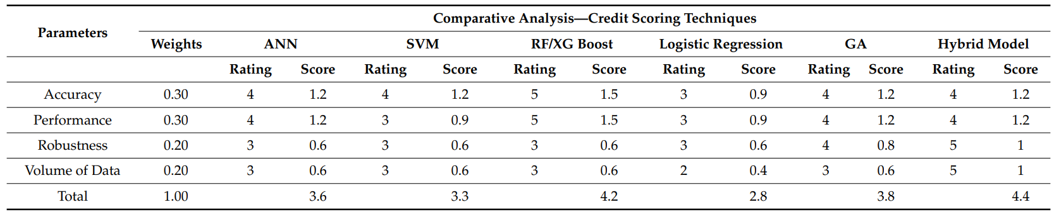
Findings and Analysis
Machine Learning (ML) Technologies for Digital Credit Scoring in Rural Finance: A Literature Review: Anil Kumar , Suneel Sharma and Mehregan Mahdavi
Risk Evaluation(individual risk, operational risk, risk of farm assets, and policy and market risk of farm produce) For Farm Assets
Credit scoring is a classification problem between the identification of defaulters and non-defaulters. Both SVM and RF are black-box models and are sensitive to hyperparameters therefore, researchers proposed a modified harmony search random factor that is more robust in terms of performance, explain ability, and computational time
AI-ML-based models which are derived from historical decisions by the loan officers may also result in bias while extending loans. Hence, to reduce the impact of human biasness it is necessary to train the data appropriately so that more robust AI-ML algorithms can be formed

Slide 7
Conclusions
Machine Learning (ML) Technologies for Digital Credit Scoring in Rural Finance: A Literature Review: Anil Kumar , Suneel Sharma and Mehregan Mahdavi
This study probably gives an insight into how these ML algorithms (highlighted by the earlier research) apply to fulfill the different objectives required by the financial institutions for the rural borrowers
AI-ML-based algorithms for credit scoring show the way for guiding their credit eligibility check in the shortest computational time with perhaps higher accuracy
Future research must be in the direction of the end-to-end implementation of ML-based technology for credit scoring
It is advisable to use real live data sets for the assessment of an AIML-based model or hybrid model for credit scoring with these existing data sets as a benchmark

Slide 8
Project Work
Data Collection
Data Pre-processing
Applying Different ML Algorithms for clustering
Results and Analysis

Slide 9
Data Collection
Demographics: Name, Aadhar No., Pan No., Phone, Marital status, Genuineness of the farmer, Family Size, City/District, State, Years of stay
Farming Details: Experience as a farmer, Land area, Soil Type, Land location, Major Crops grown, Quantity produced for each crop, Selling price for each crop, Water access on a scale of 1-10, Most used Machineries
Capital Strength: Monthly income, Previous Loans history, Purpose of taking loans, Available assets valuation, Valuation of the asset sold recently, Partners Details, How healthy is the farmer (1-10), Other income sources (if any), Average Monthly expenditure

Slide 10
Data Pre-processing: Taking care of missing data
Removed some rows containing more that 5 empty features and in case the number is less that 5, we replaced them with average values
In some cases we converted Nan to 0
Removed the following columns First Name, Aadhar No., Pan No., Phone, etc.

Slide 11
Data Pre-processing: Encoding categorical data
Last Name, Marital Status, City/District, State, Soil type, Land Location, Major Crops Grown, Most used machineries
We used ’OneHotEncoder’ included in the ’scikitlearn’ library

Slide 12
Applying Different ML Algorithms
Majority the methods that are discussed in the paper are applicable only when there is label data
Credit scores to farmers have not been there in India
The data we’ve collected is not labeled i.e. credit scores are not assigned to the farmers
The data could be analyzed to look for similar behavior of farmers by applying clustering technique
This will help in getting insights about offering different loan offers for different groups of farmers.

Slide 13
Applying Different ML Algorithms: Clustering
Finding the optimal number of clusters: Elbow Method, Dendrogram Method
K Means clustering
Hierarchical Clustering

Slide 14
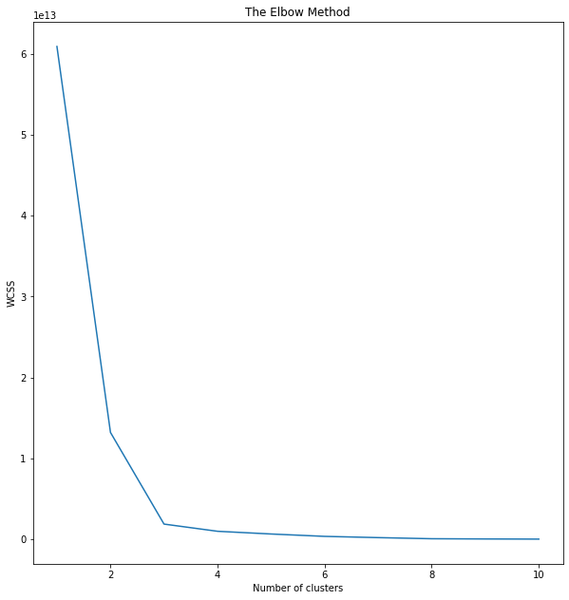
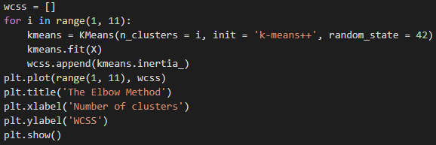
Clustering: Finding the optimal number of clusters: Elbow Method
This method calculates the Within-Cluster-Sum of Squared Errors (WSS) for different values of k(no. of clusters), and choose the k for which WSS becomes first starts to diminish.

Slide 15
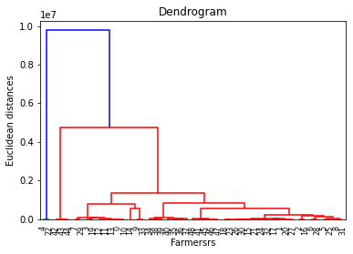
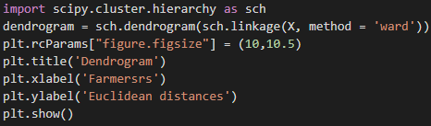
Clustering: Finding the optimal number of clusters: Dendrogram Method
A dendrogram is a type of tree diagram showing hierarchical clustering i.e. relationships between similar sets of data.

Slide 16
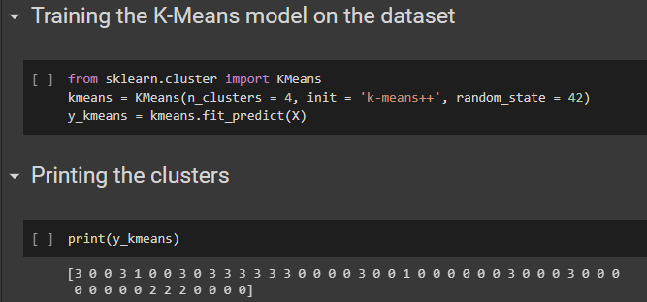
Clustering: K Means Clustering
K-means is a centroid-based algorithm, or a distance-based algorithm, where we calculate the distances to assign a point to a cluster. Each cluster is associated with a centroid
This algorithm tries to minimize the distance of the points in a cluster with their centroid.

Slide 17
Clustering: Hierarchical Clustering
In this algorithm, we develop the hierarchy of clusters in the form of a tree, and this tree-shaped structure is known as the dendrogram
Agglomerative It is a bottom-up approach, in which the algorithm starts with taking all data points as single clusters and merging them until one cluster is left
Disive Divisive algorithm is the reverse of the agglomerative algorithm as it is a top-down approach.

Slide 18
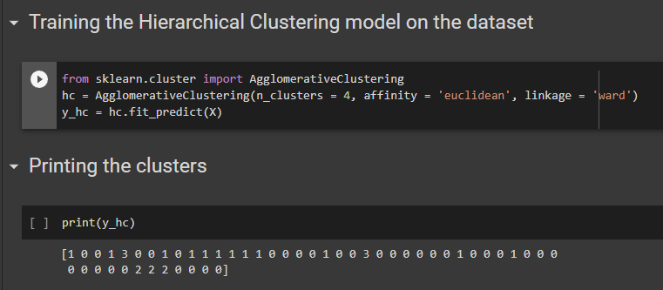
Clustering: Hierarchical Clustering

Slide 19
Results and Analysis
We had run the codes of ’K Means clustering’ and ’Hierarchical clustering’ by taking number of clusters to be 4
The clusters created for both of them are Cluster 0, Cluster 1, Cluster 2, Cluster 3
Next we wanted to see that if same farmers are assigned to different clusters or not
But, both the algorithms did the exact

Slide 20
Results and Analysis
This might be because of the small number of data
Main factors that are motivating the clusters are the followings:
Surname
Land Area
The quantity produced by each crop
Selling price for each crop

Slide 21
Conclusion and Future Work
By analyzing the data using appropriate machine learning techniques, we can come up with an efficient credit scoring model that assigns a credit score to farmers or rank the farmers as per their potential to repay the loan thus mitigating the risks involved in lending
We’re working on ranking the clusters and trying to fit a range of credit score to each clusters
Later on we will go more deep into the clusters i.e. assigning a credit score range to individual farmers

Slide 22
References
[1] Anil Kumar K, Suneel Sharma, M. Mahdavi. 2021. Machine Learning (ML) Technologies for Digital Credit Scoring in Rural Finance A Literature Review [https://www.mdpi. com/2227-9091/9/11/192/htm]
[2] Credit scoring using the hybrid neural discriminant technique: Tian-Shyug Leea, Chih-Chou Chiub , Chi-Jie Luc , I-Fei Chend
[3] New hybrid data mining model for credit scoring based on feature selection algorithm and ensemble classifiers: Jasmina Nalić, Goran Martinović , Drago Žagar

Slide 23
Thank You

